Slide 1

Brighterion Solutions
ADAPTIVE LEARNING
NEURAL NETWORKS
CASE-BASED REASONING
DATA MINING
SMART
AGENTS
GENETIC ALGORITHMS
REAL-TIME, LONG-TERM,
GEO, RS PROFILING
FUZZY LOGIC
BRMS / BUSINESS RULES
UNSUPERVISED LEARNING
Real-time, cross channel transaction scoring
Adaptive Learning evolves with shifting fraud patterns
1:1 profiling of individual payment accounts and merchants

Slide 2
Automated Modeling Process
D.A. Engine
Any format
Any volume
Any sources
Data Expansion
Data Cleaning
Data Enrichment
Profiles
Automated model creation
10 A.I. technologies
Customer Data
Technologies
Implementations Go Live in 4-8 Weeks

Slide 3
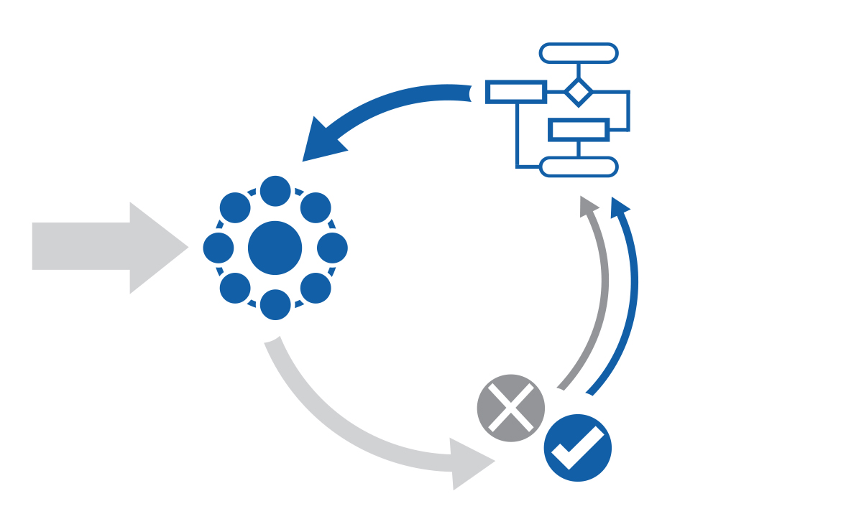
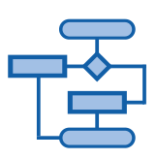




Adaptive Learning
Update
Model
Incremental
Learning
Algorithms
Input Data
Model
Reconciled Outputs
Scored
Data

Slide 4
Key Performance Metrics
REAL-TIME, near real-time and batch trade processing
Highly-scalable distributed architecture
BILLIONS of transactions processed per month per server
Less than 10 millisecond response times
99.999% Guaranteed operational uptime
Longest model lifespan on market

Slide 5
Integration, Installation & Implementation
Easy Integration
Works with any existing data feeds and infrastructure
Natively supports all major data types
Handles structured and unstructured data
Handles multiple data sources in parallel
Painless Installation
No data warehouse requirement
Works with off-the-shelf, mid-range servers
No expensive databases for analytics or storage
Fast Implementation
Only 2-3 days of user training required
4-8 weeks to go-live, battle tested number
Dynamic deployment

Slide 6


